Slide 1


IEEE S&P
“Only as Strong as the Weakest Link”:
On the Security of Brokered Single Sign-On on the Web
Tommaso Innocenti, Louis Jannett, Christian Mainka, Vladislav Mladenov, Engin Kirda (Appearing in S&P’25)

Slide 2
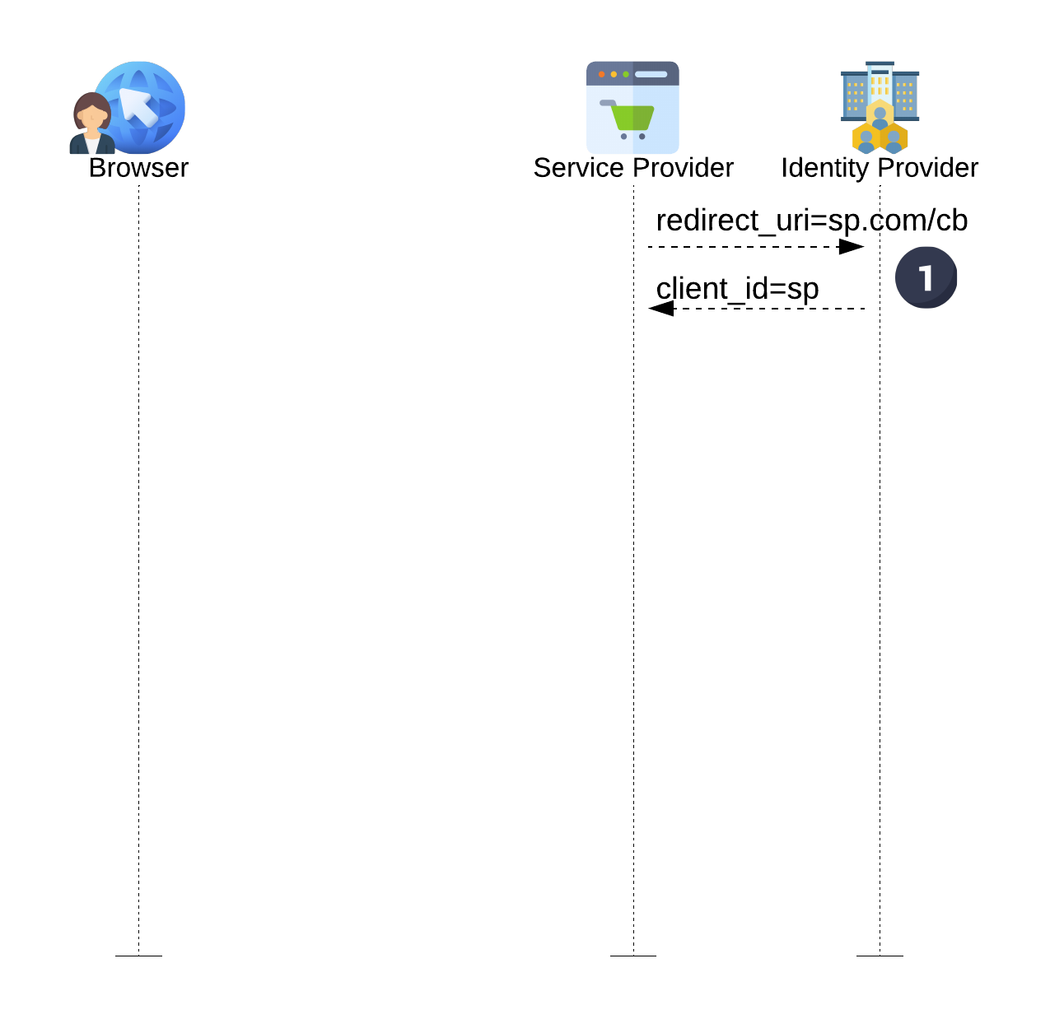
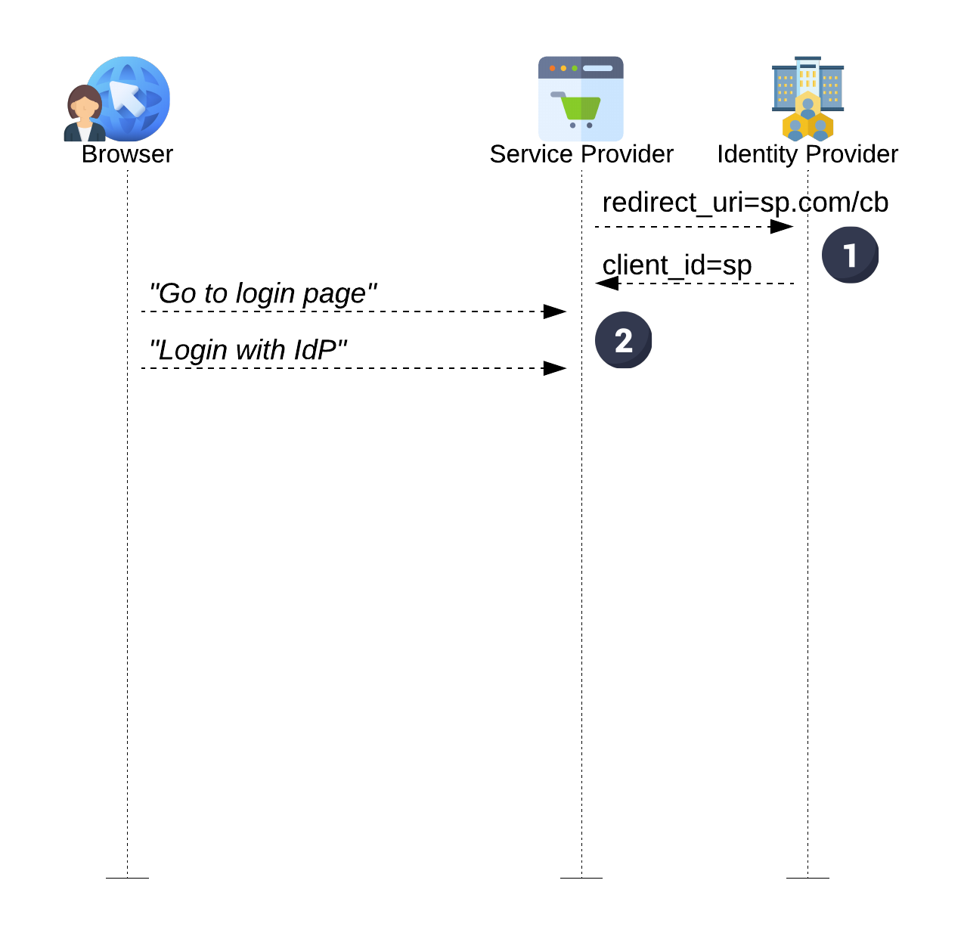
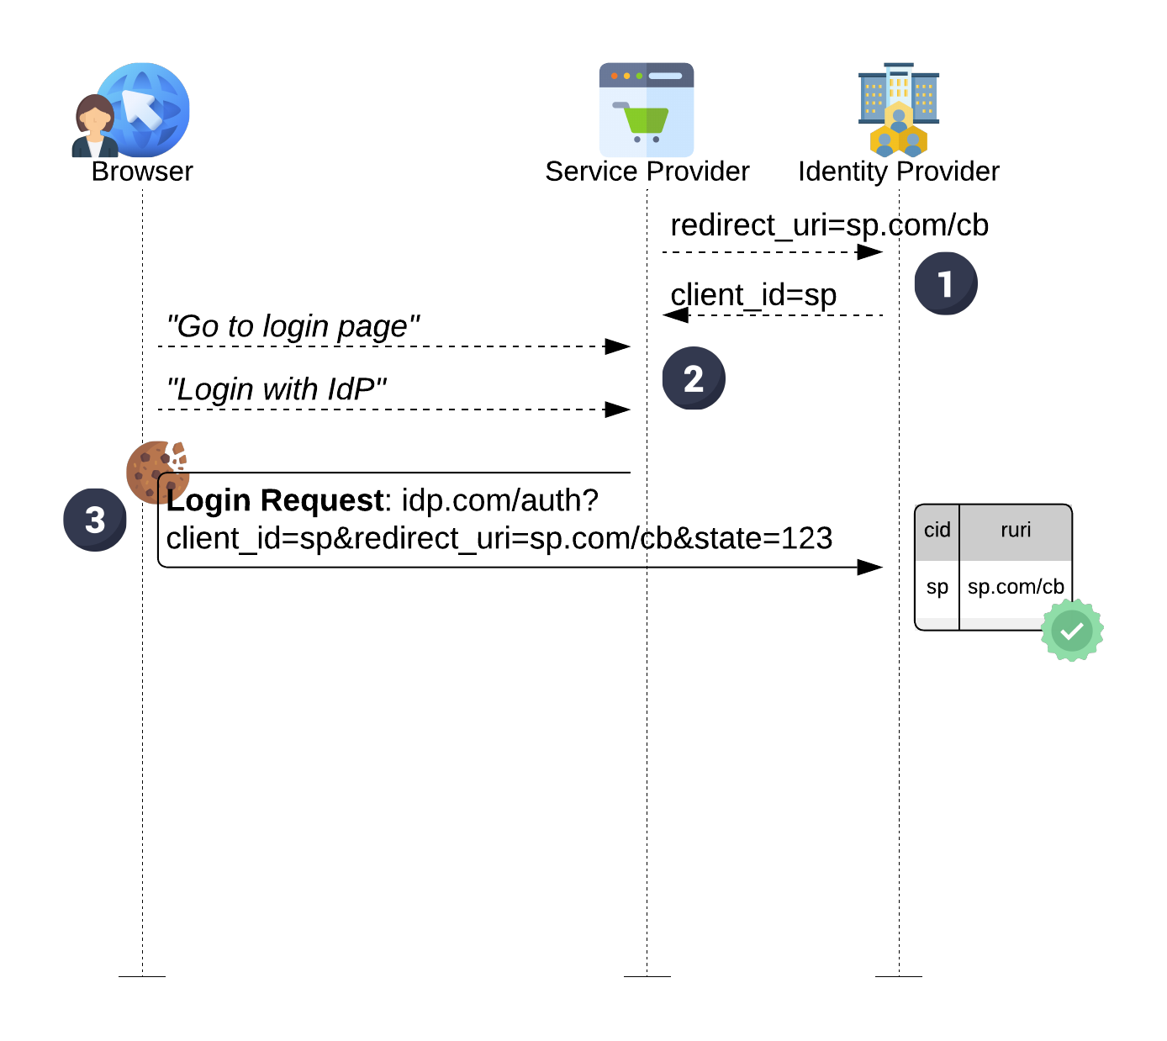
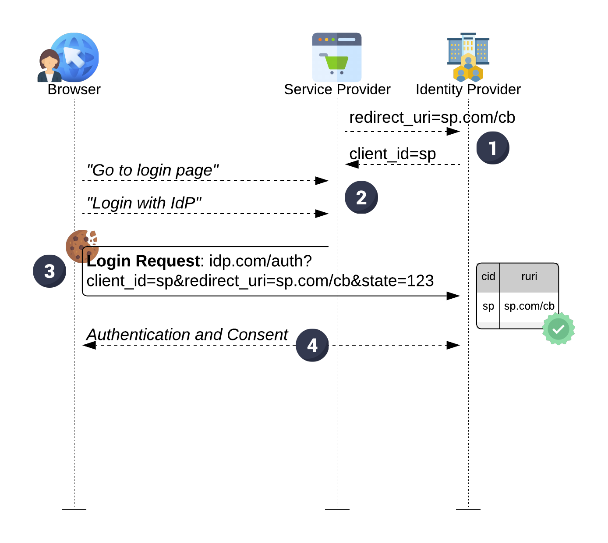
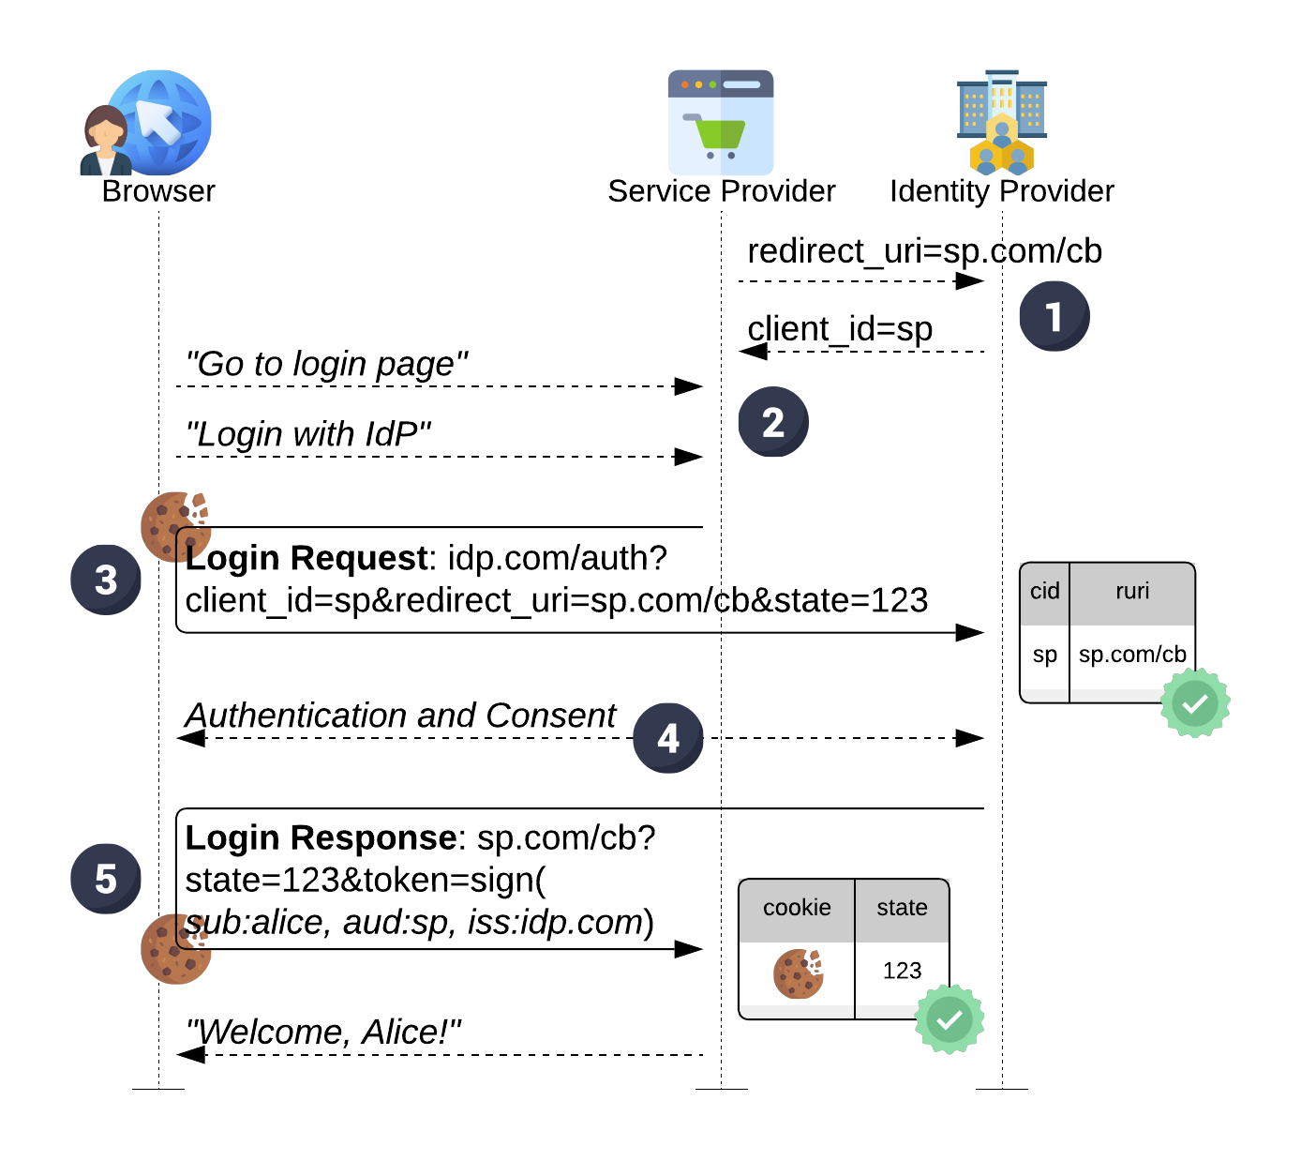
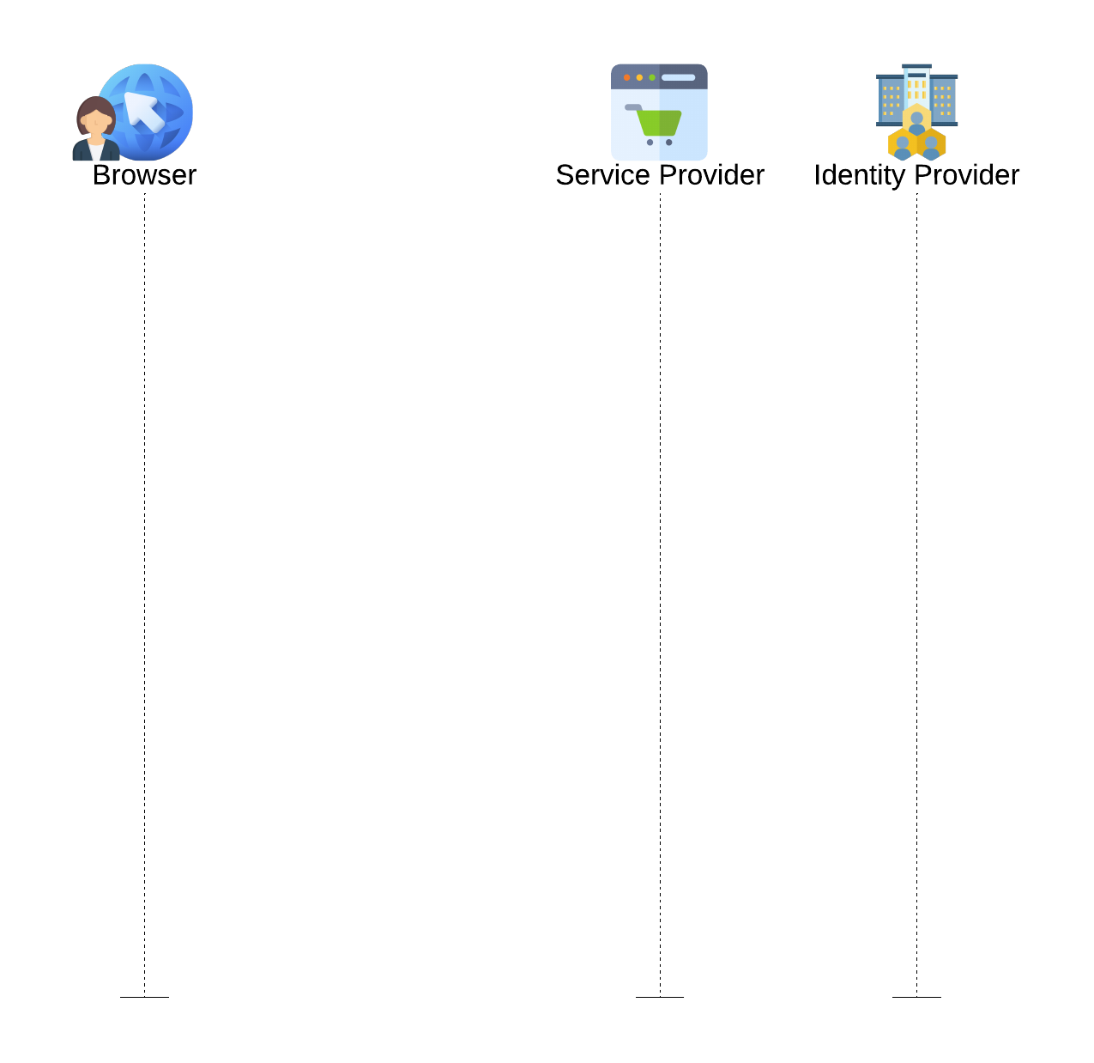






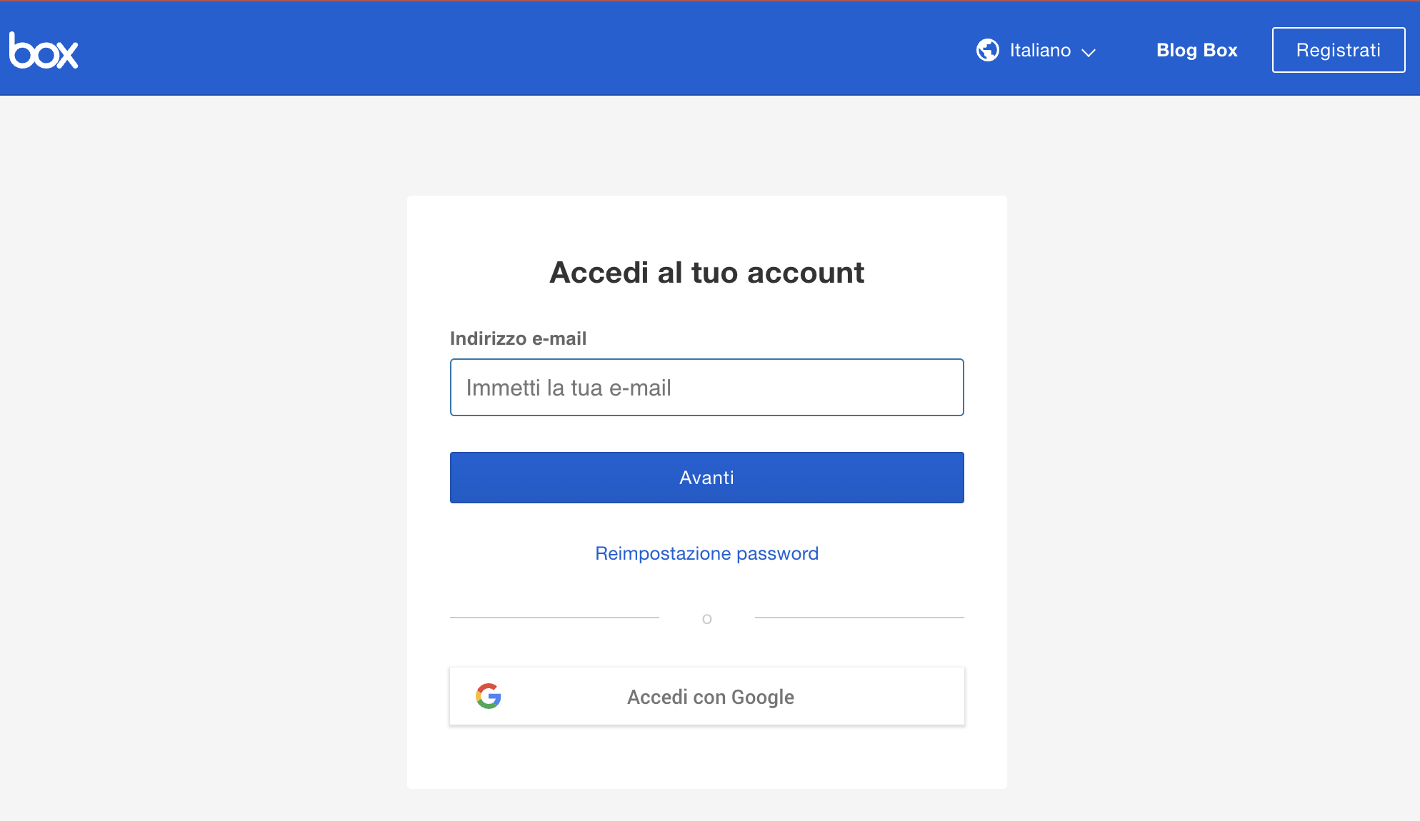
Traditional SSO Flow:
Registration phase
Login flow

Slide 3
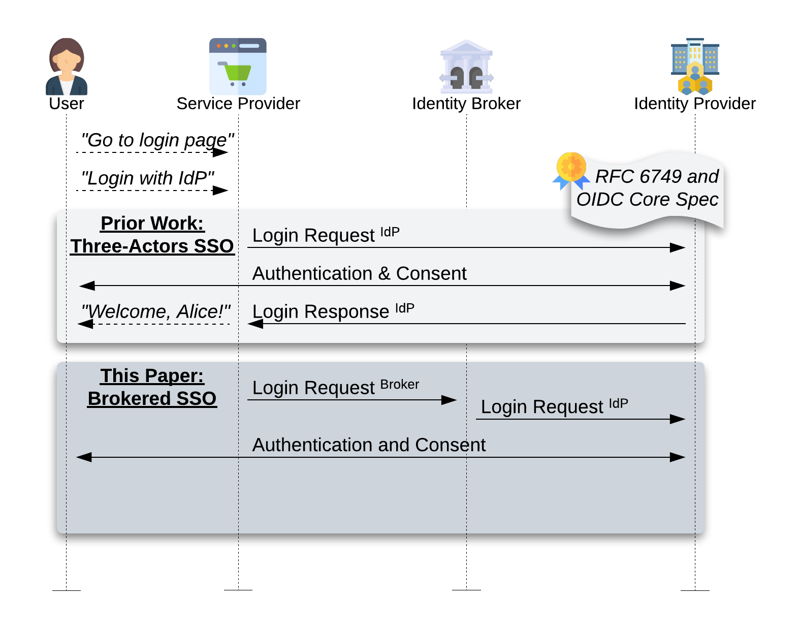

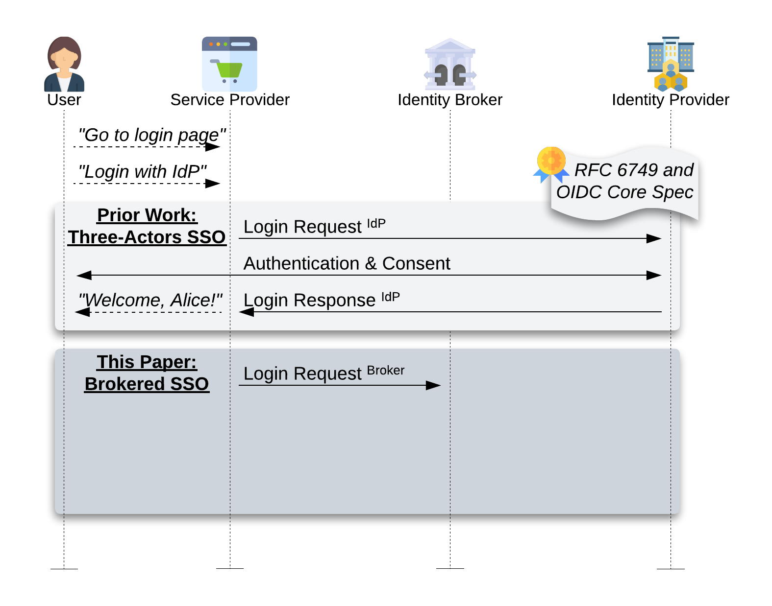





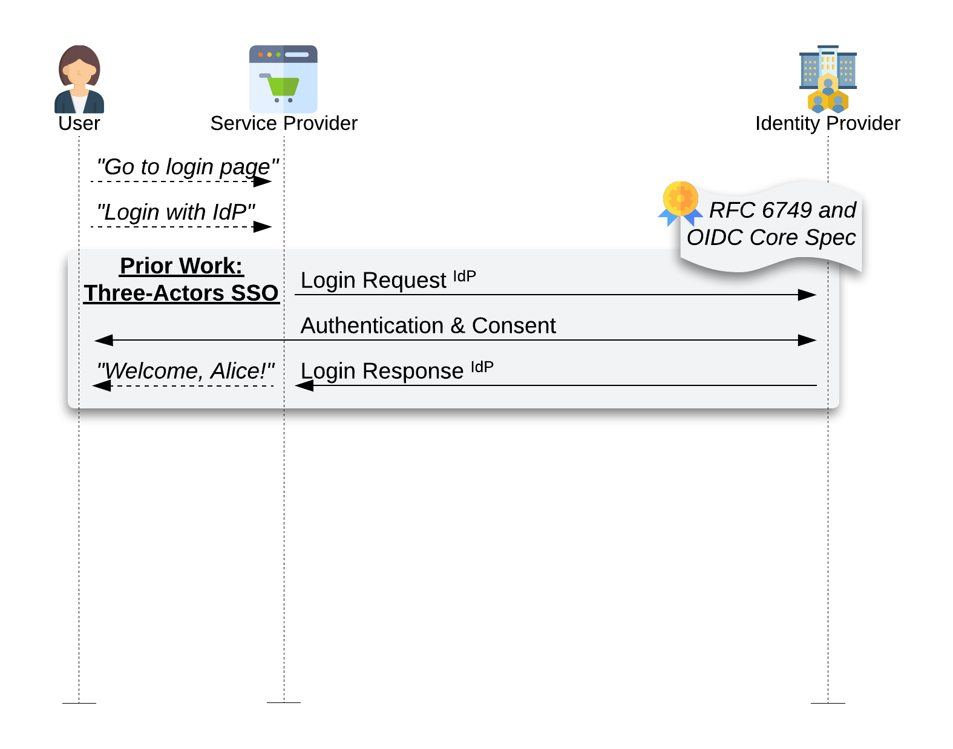
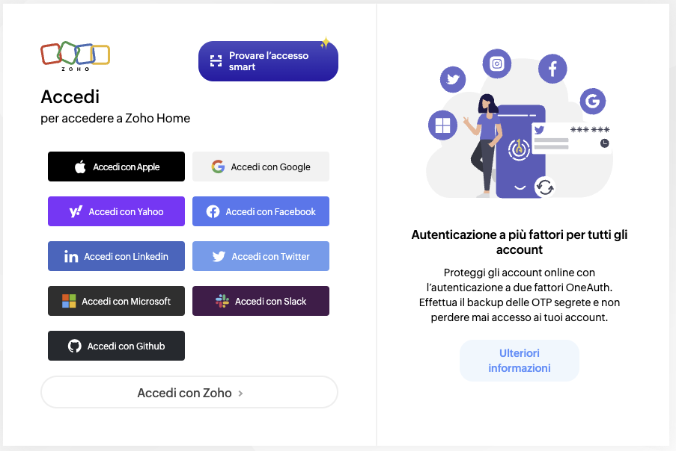
Traditional SSO Flow
vs.
Brokered SSO Flow:
Identity Brokers in the login flow

Slide 4
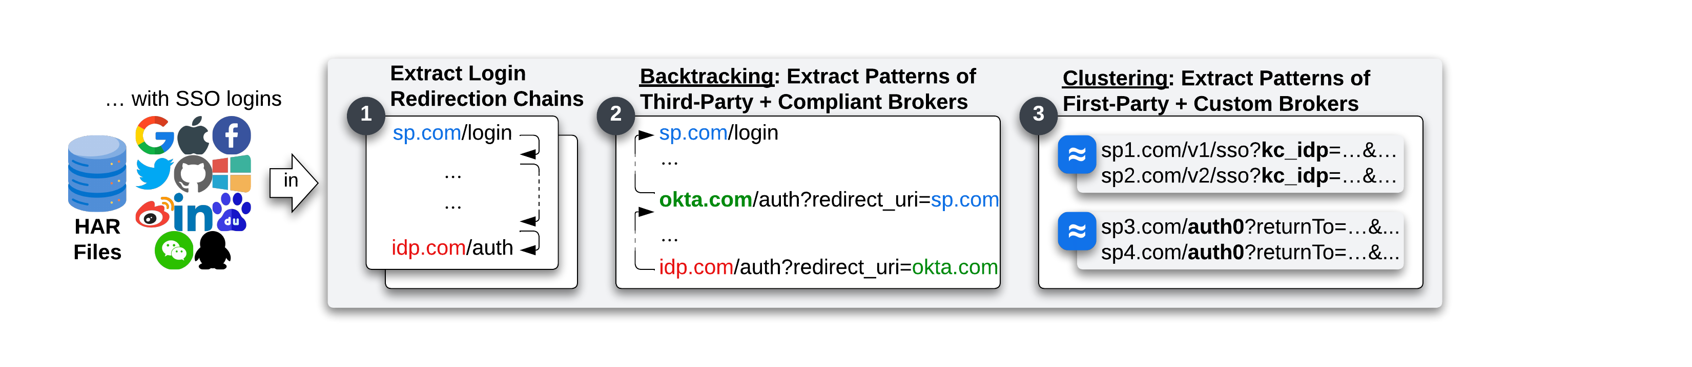
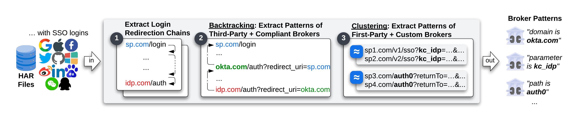
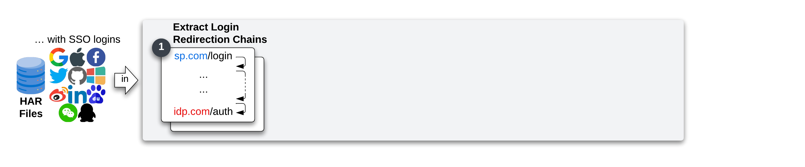
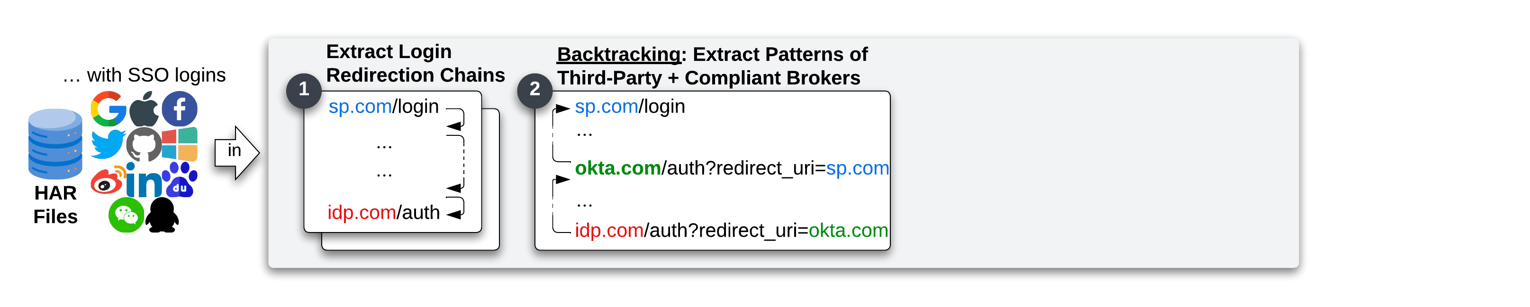
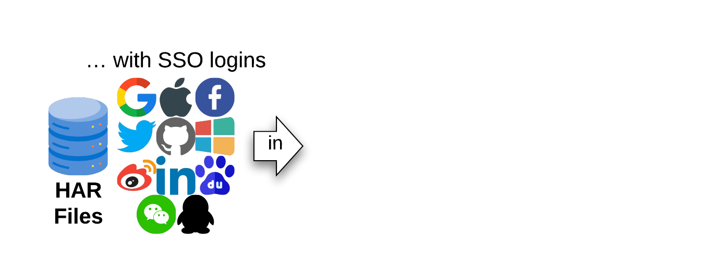
Methodology
Identity Brokers Systematization
SP relation:
First-party or Third-parties
Audience:
Public or Internal

Slide 5
Brokered SSO adoption
The percentage of websites using a brokered SSO is constant among the Top1M Tranco list (~25% of SSO)

Slide 6



Brokered SSO Flow Major Problems:
One Consent for 4 Actors
Client ID Reuse
Login Request / Response Confusion

Slide 7
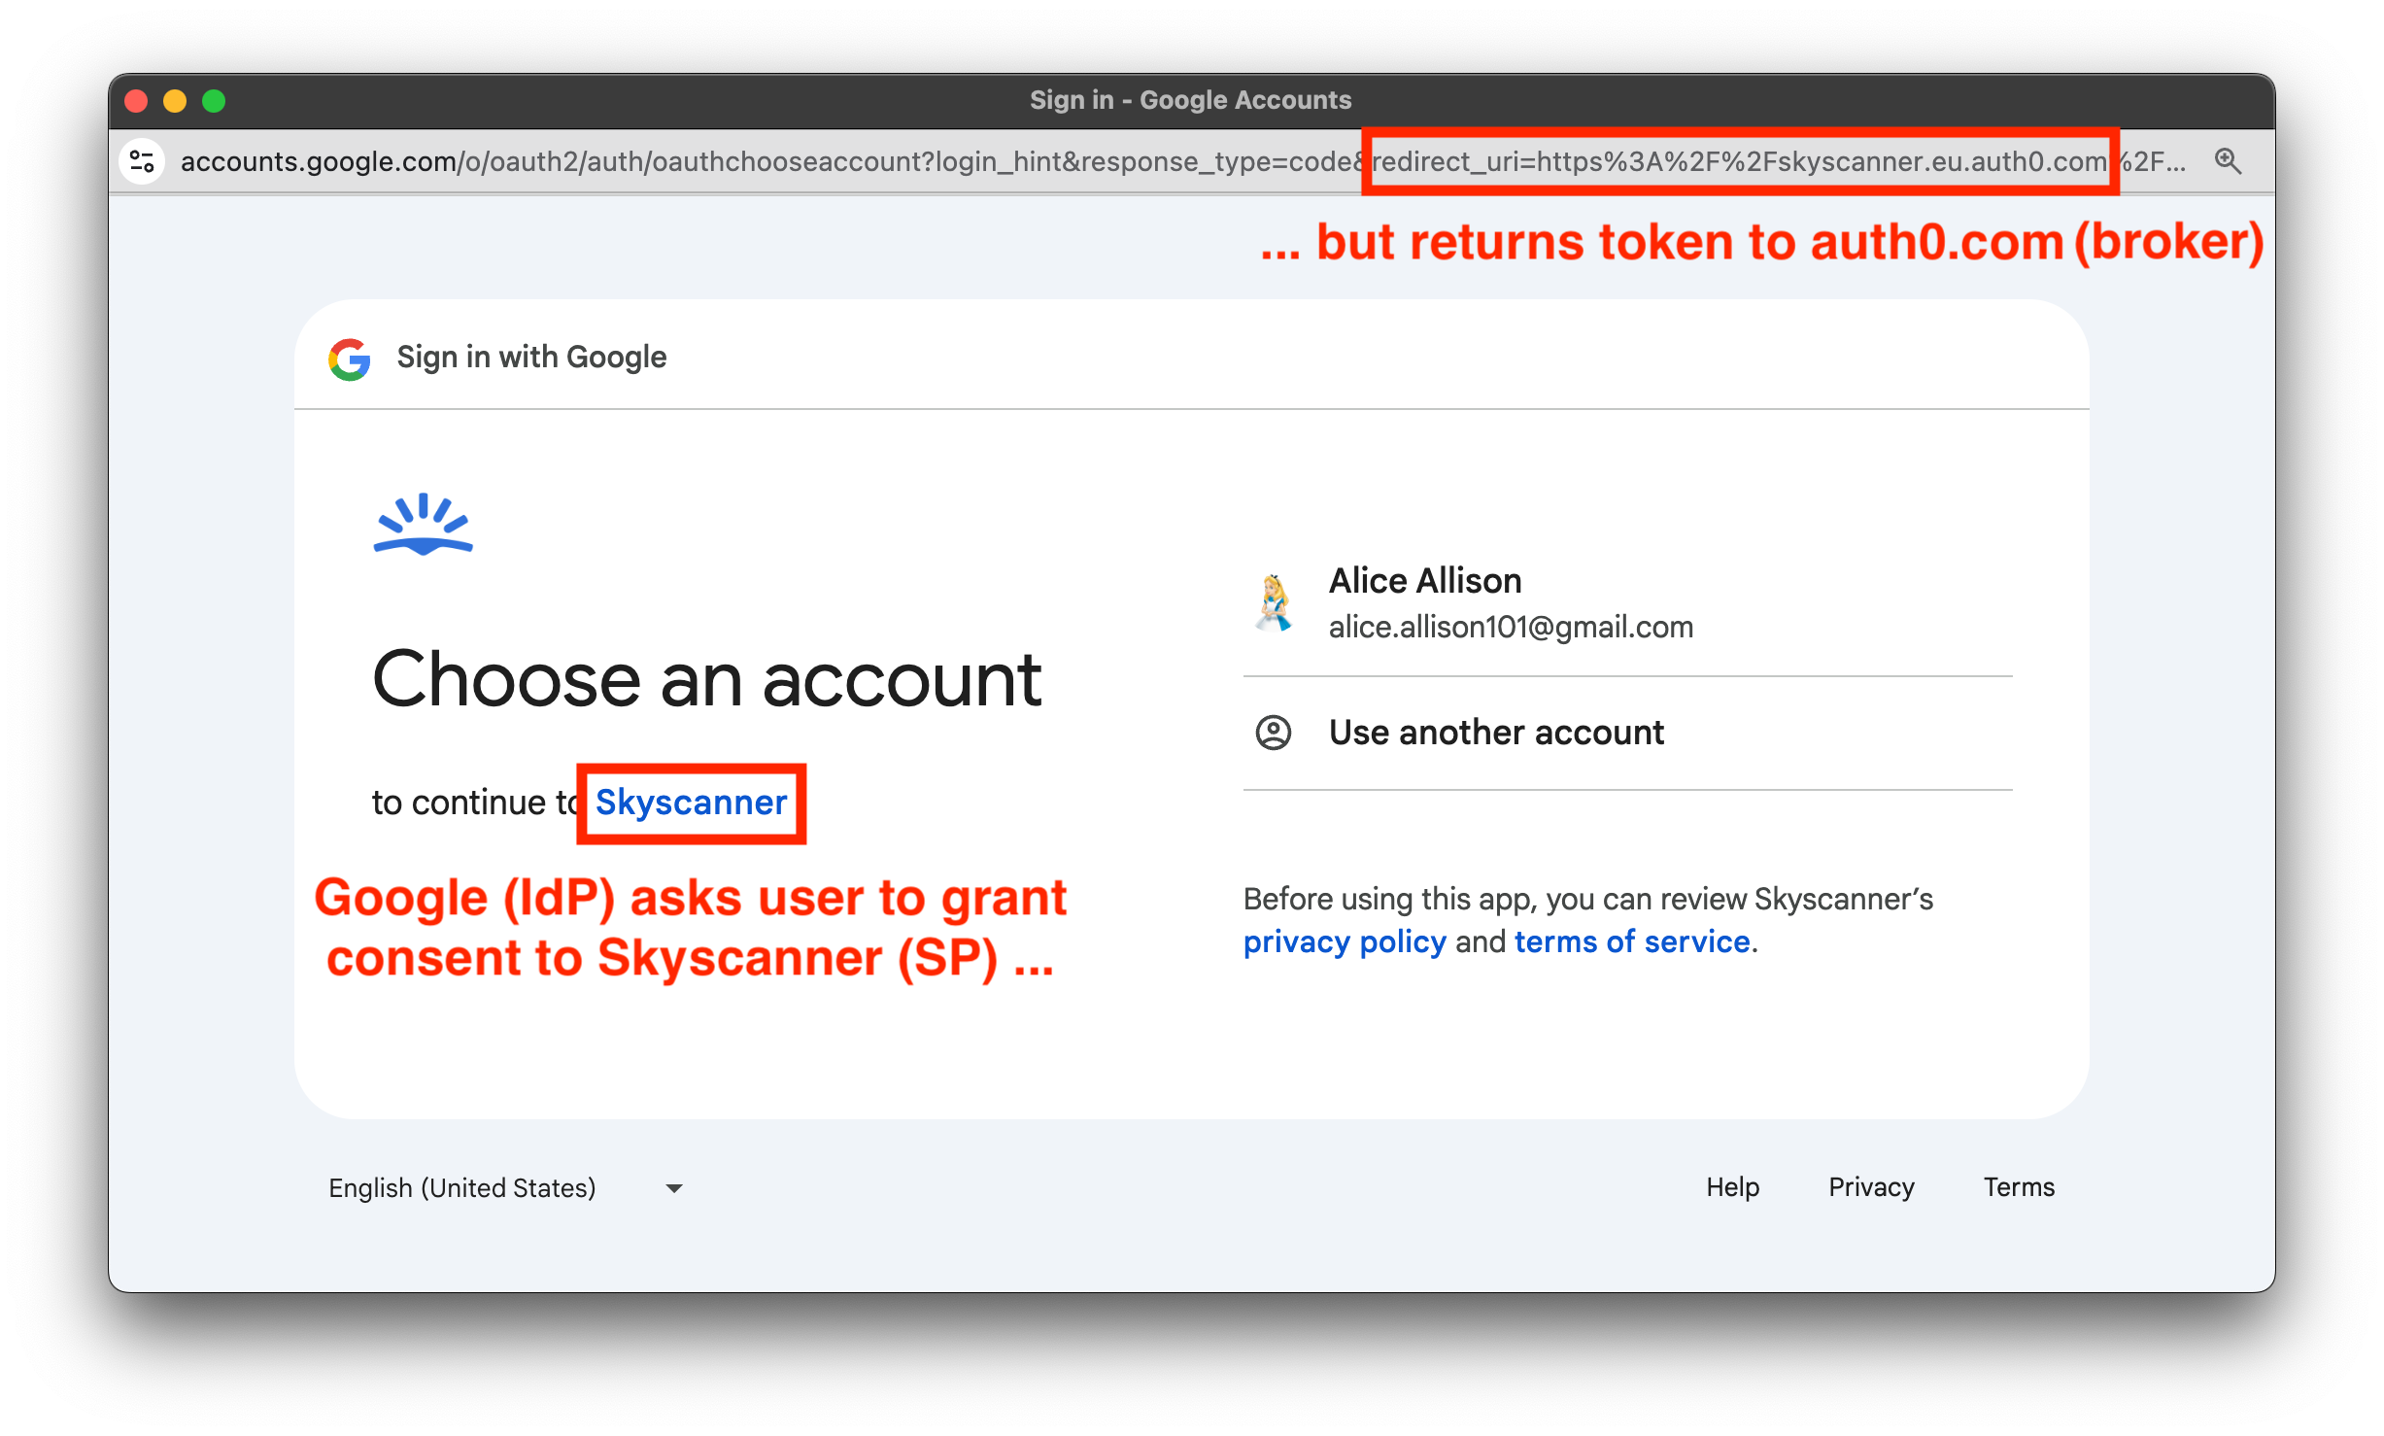
One Consent for 4 Actors
Two logically chained OAuth flows
but only one consent prompt
Two consent prompts introduce
friction in the login flow and can
confuse the users
All consent prompts in Brokered
SSO hides the presence of the Identity Broker

Slide 8
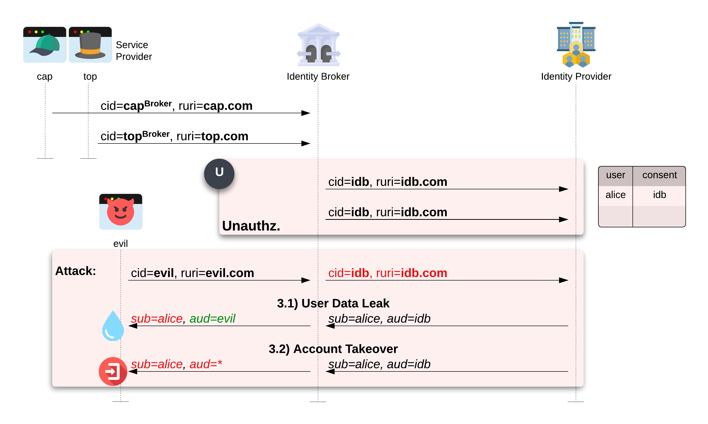
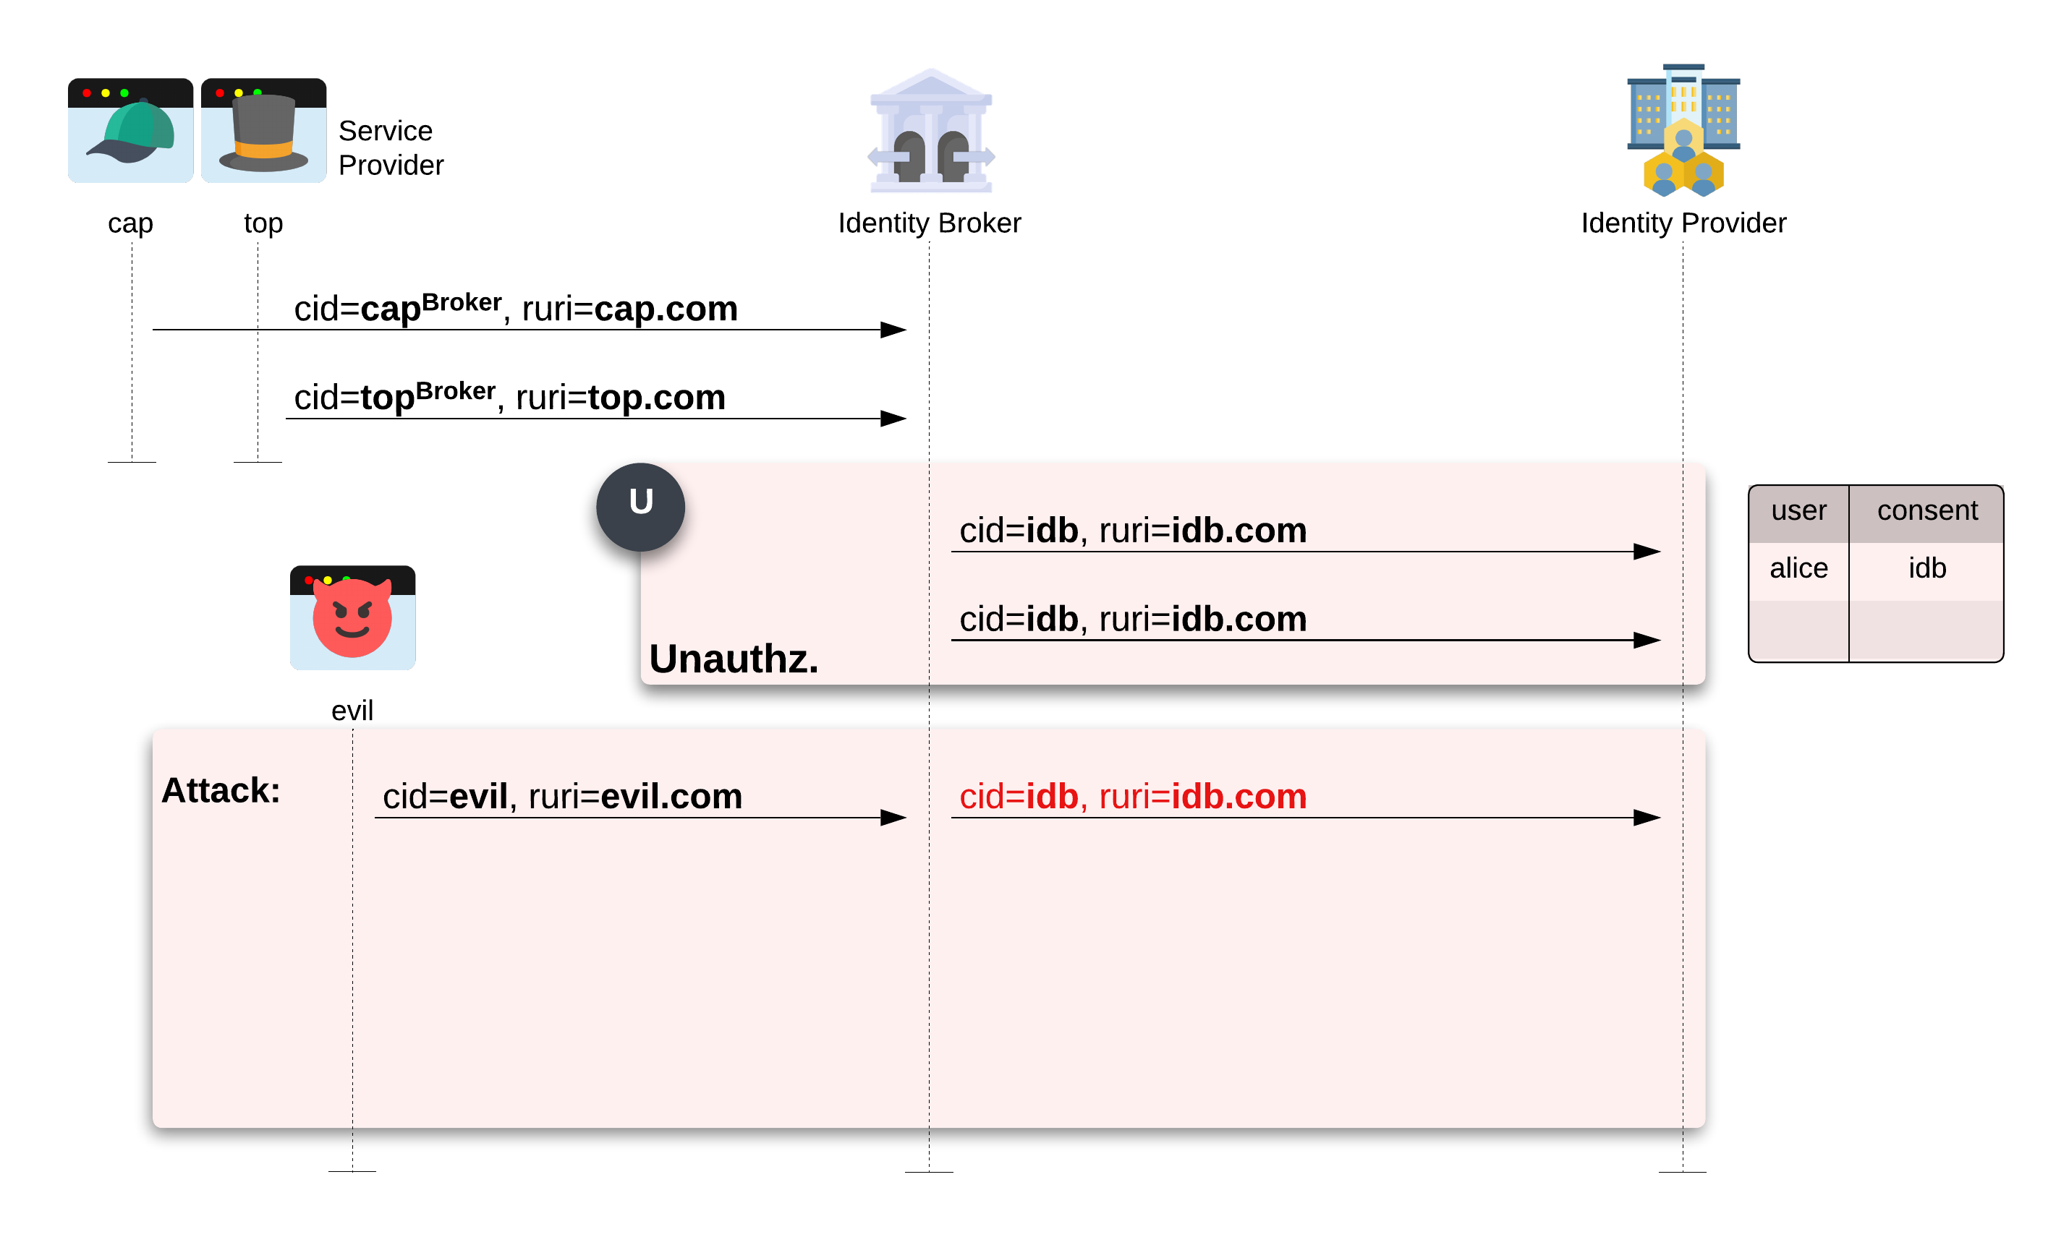
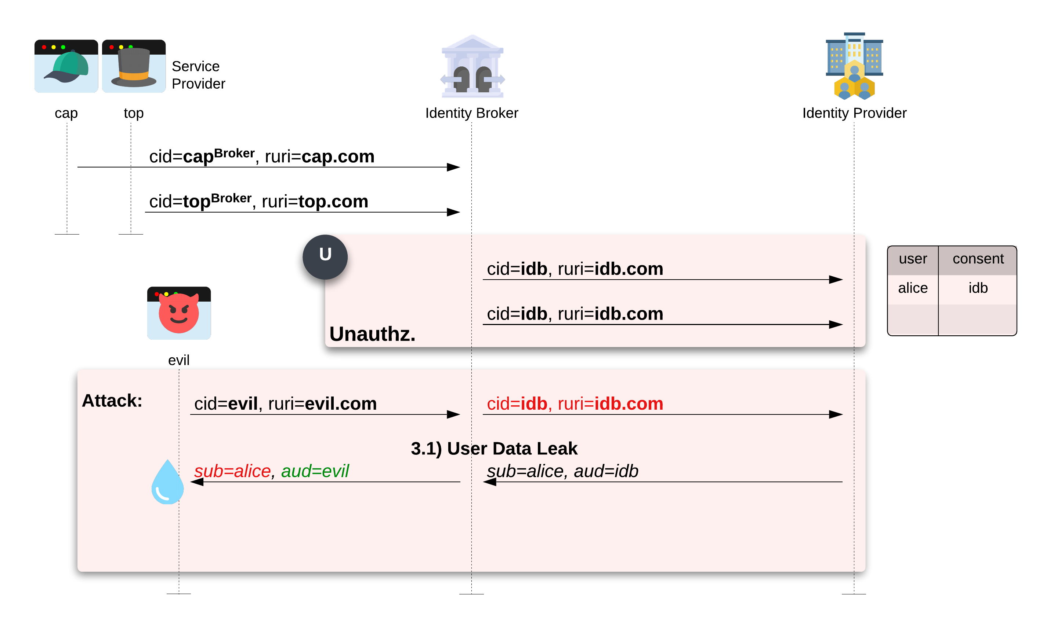
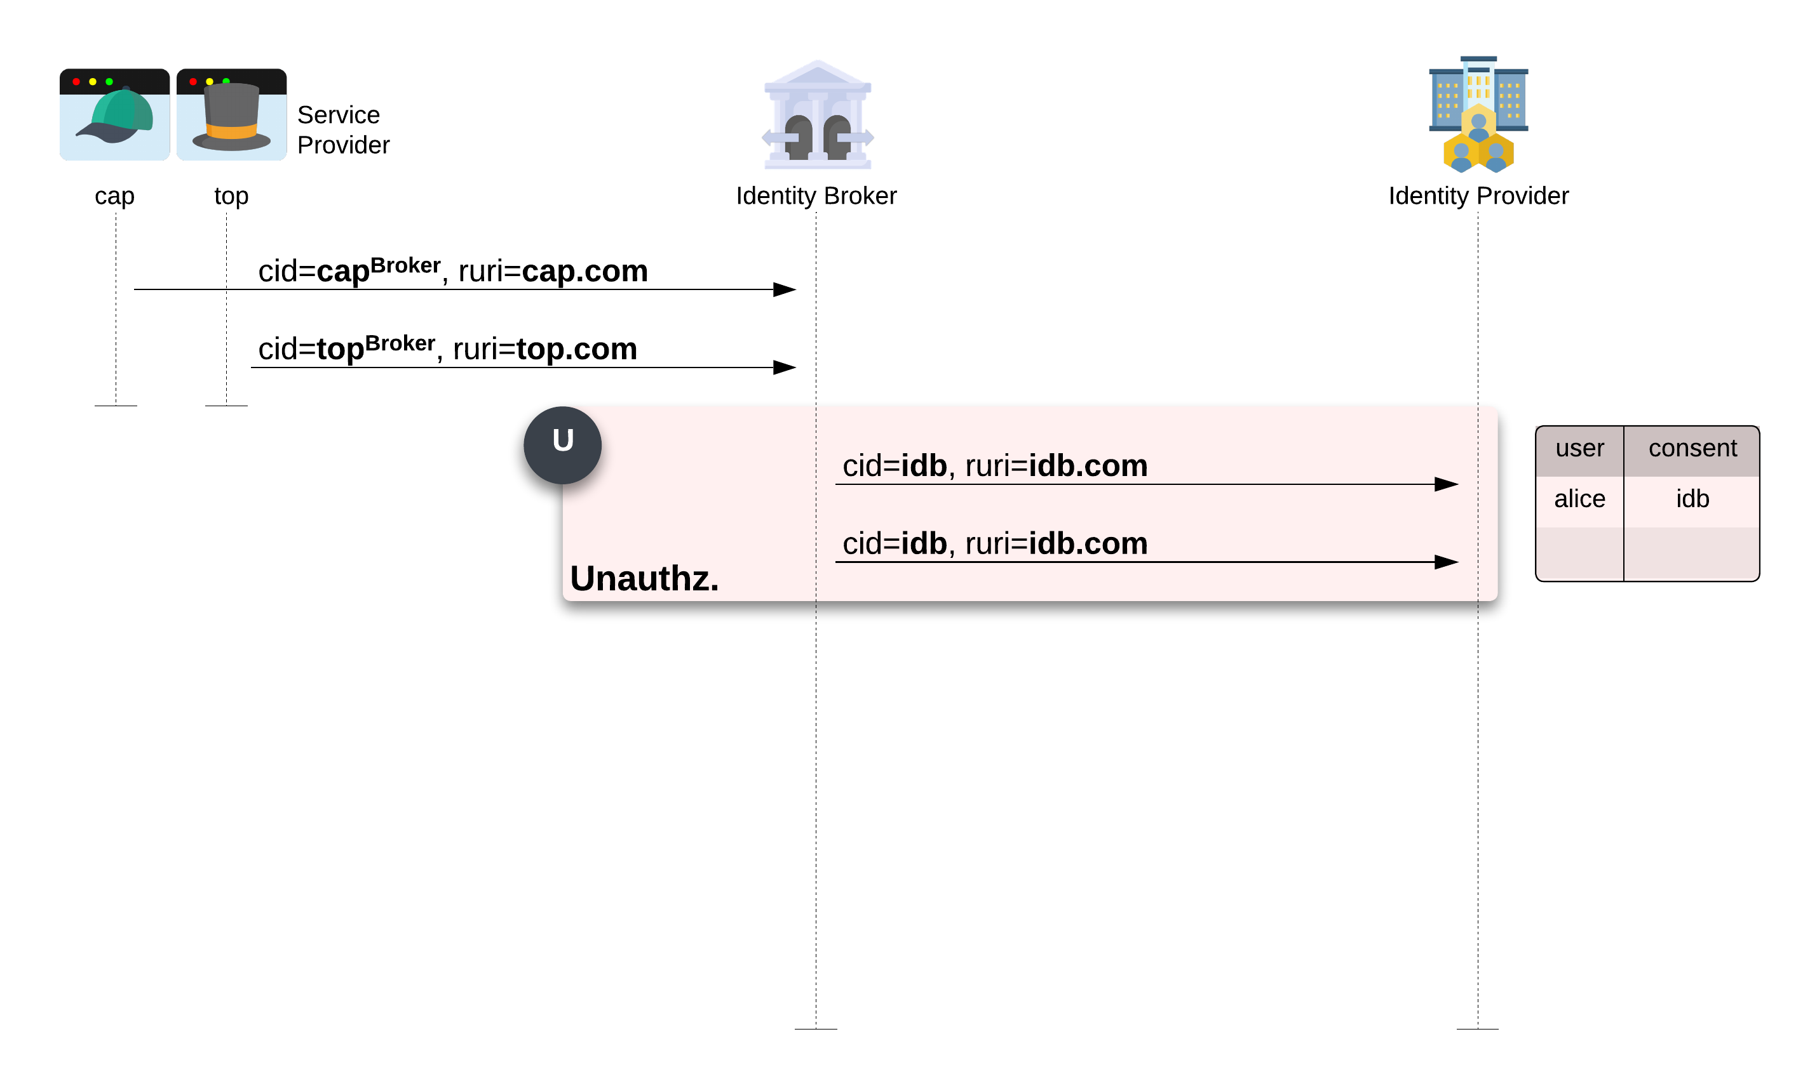
Client ID Reuse
Identity brokers only use one
Client ID for all SPs
User’s information Leak
Account Takeover
15 Identity Brokers vulnerable to
user’s information leak
6 Identity Brokers issued unscoped
authorization token

Slide 9
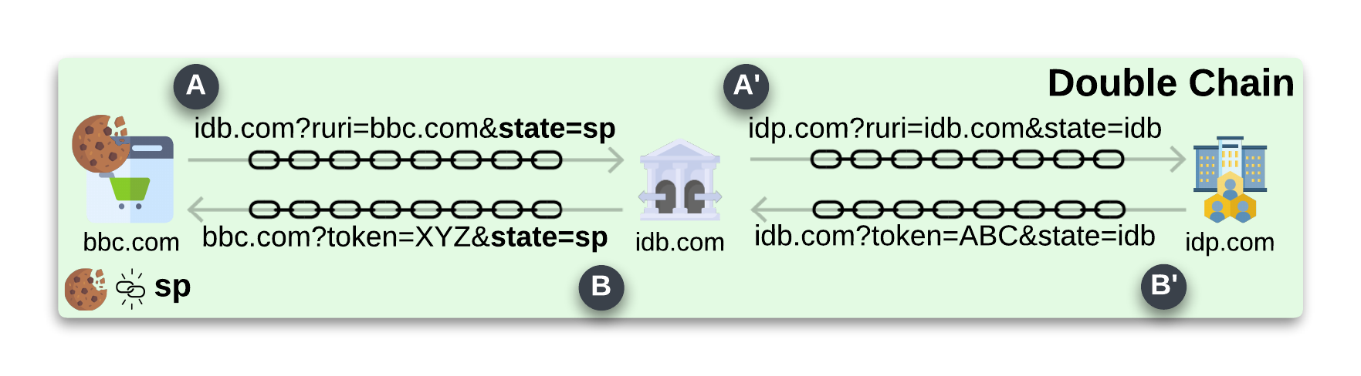
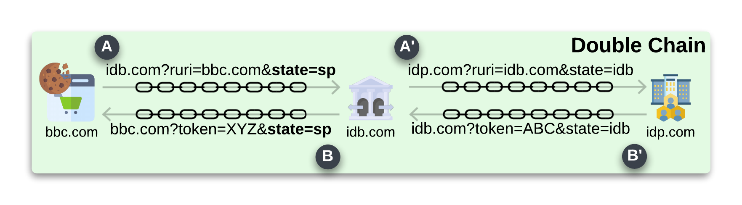
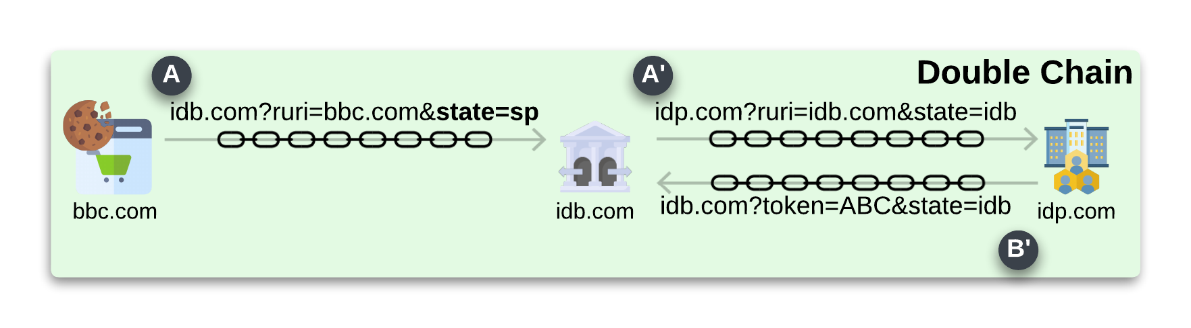
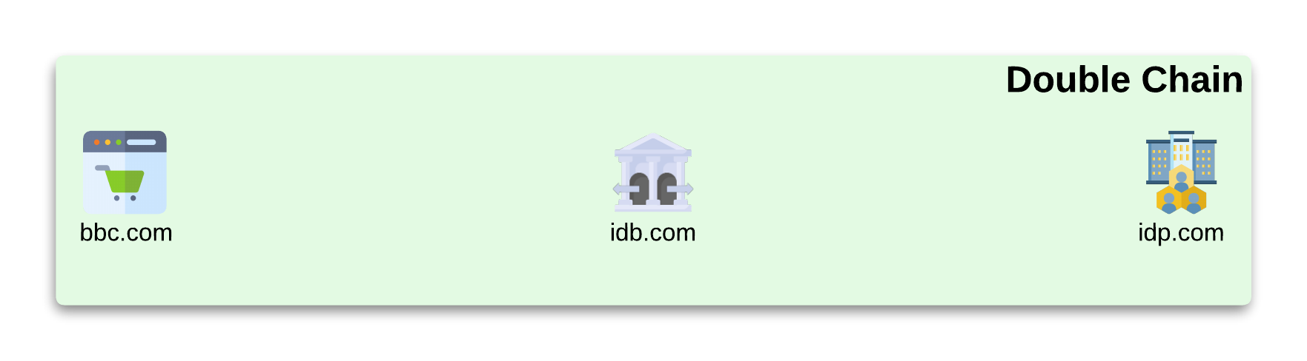
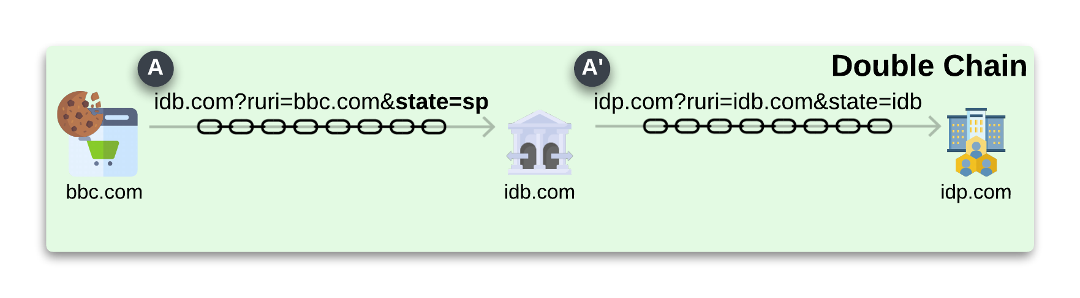
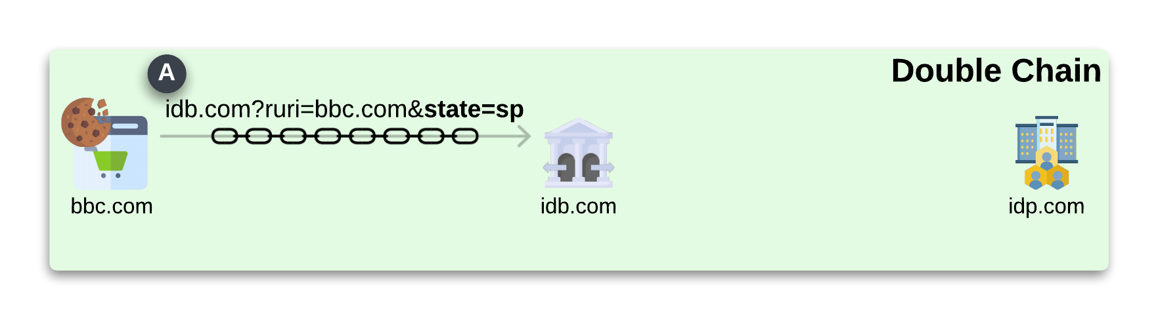
Correct chain scheme Brokered SSO
The double chain scheme allows
a correct implementation of the Brokered SSO

Slide 10
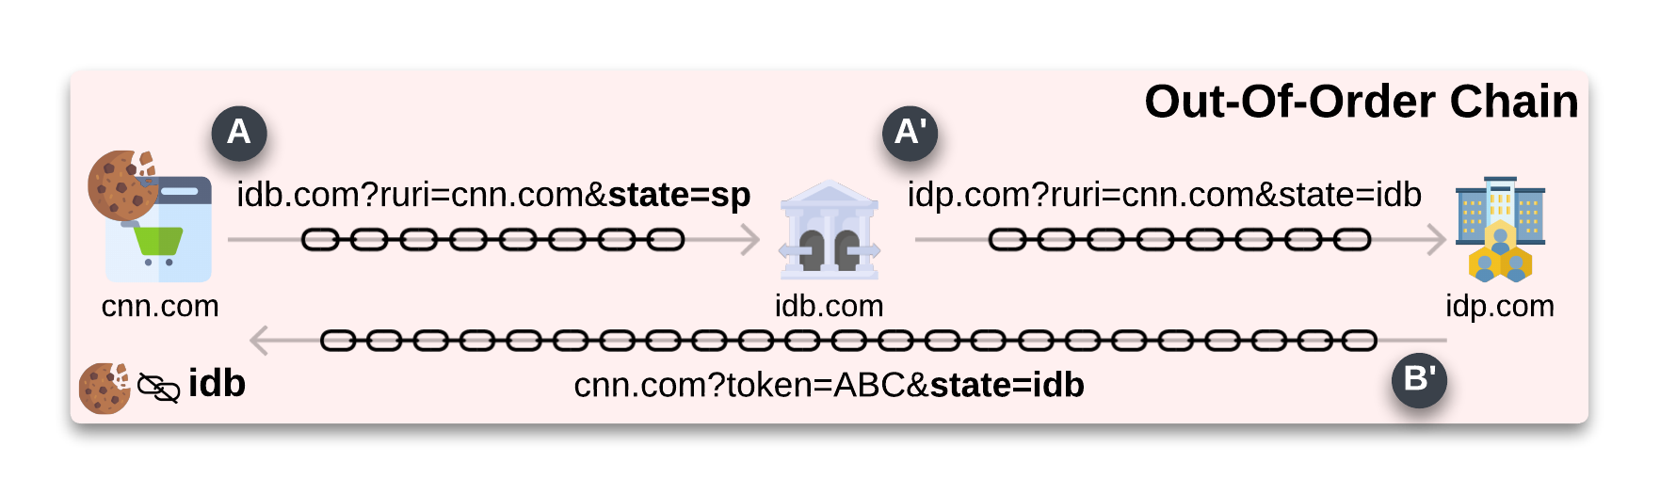
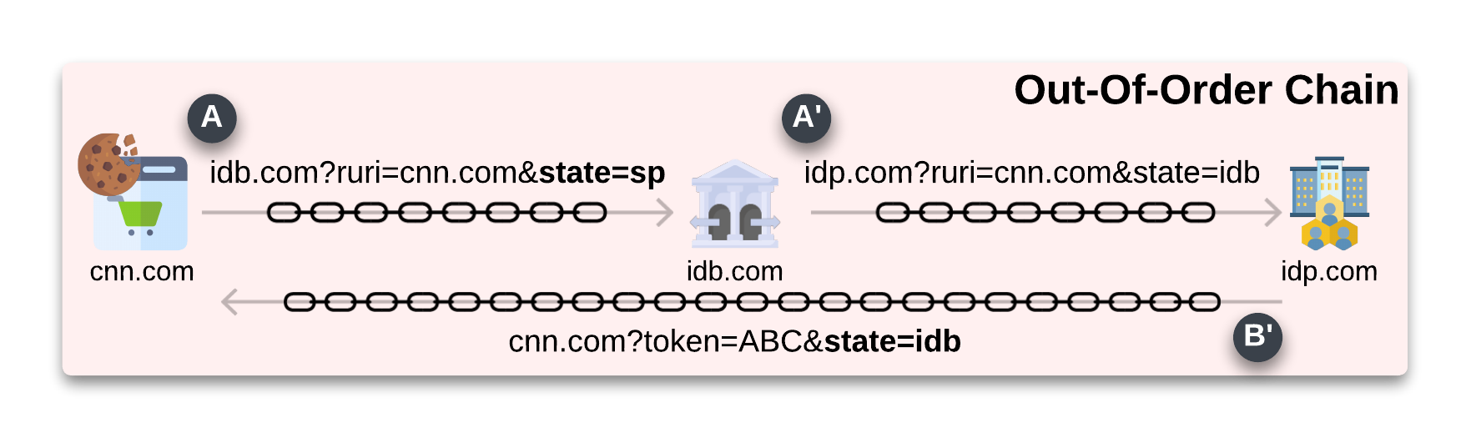
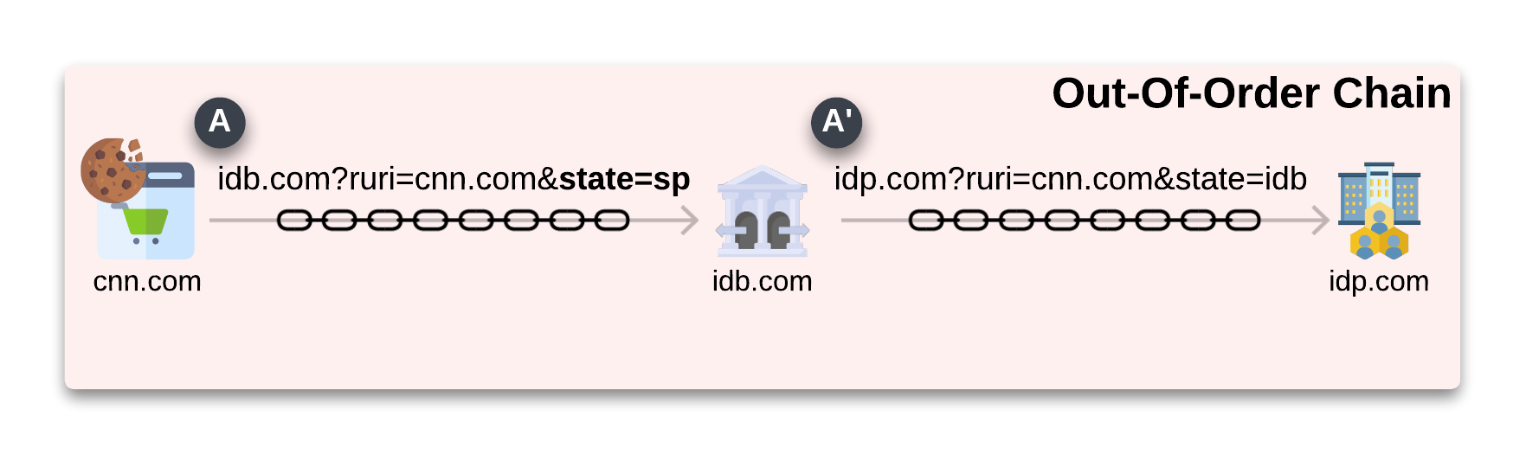
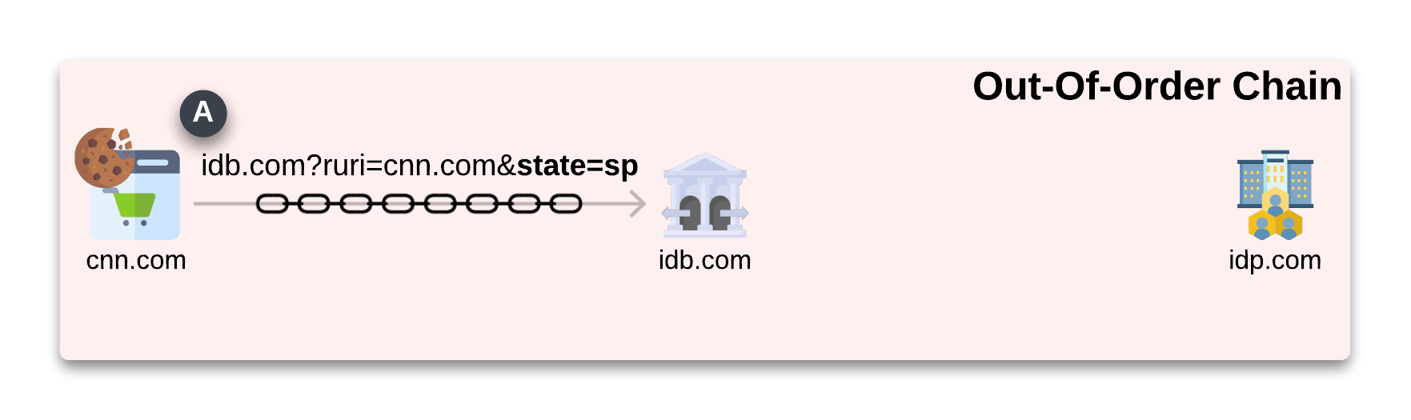
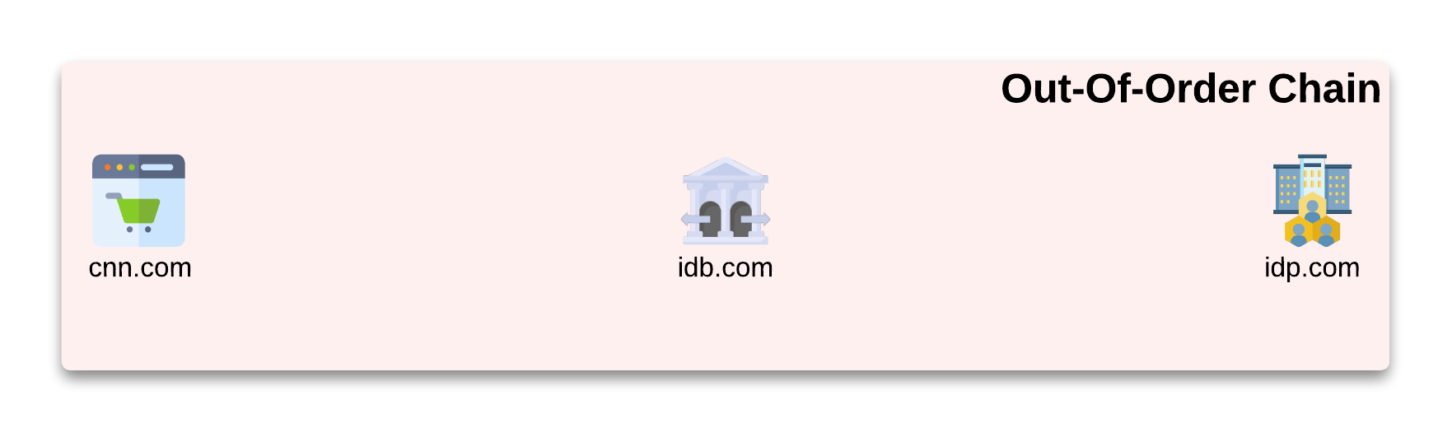
Login Request / Response Confusion
Out-Of-Order chain scheme
blocks the correct parameter validation, exposing the login flow to the LoginCSRF attack
69 Brokered SSO flows used the
Out-Of-Order chain scheme

Slide 11
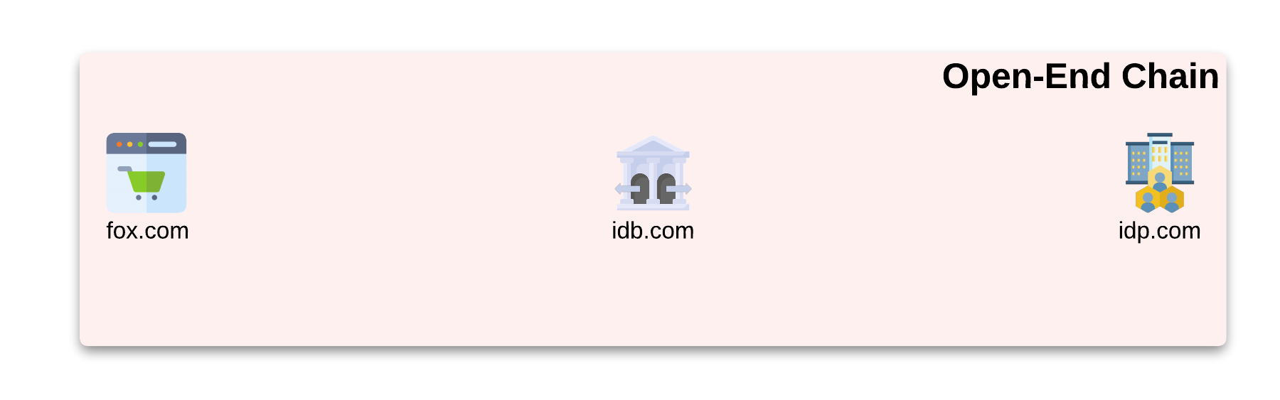
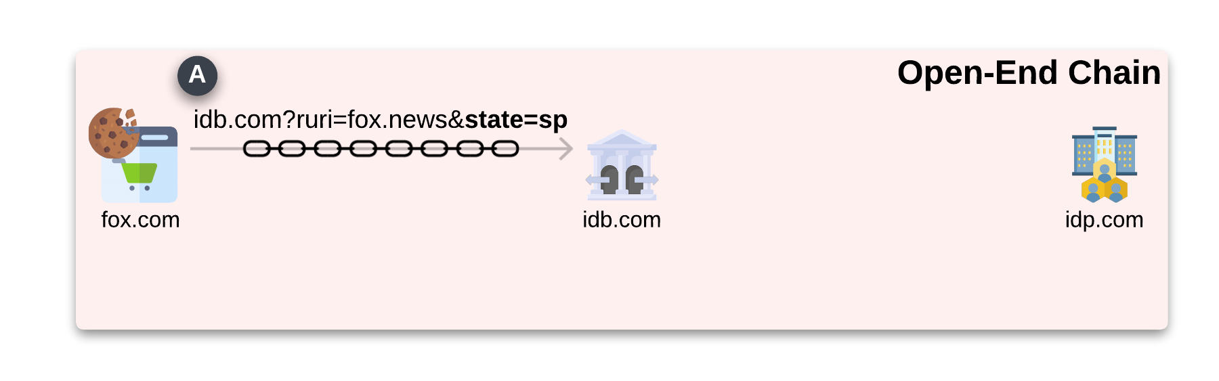
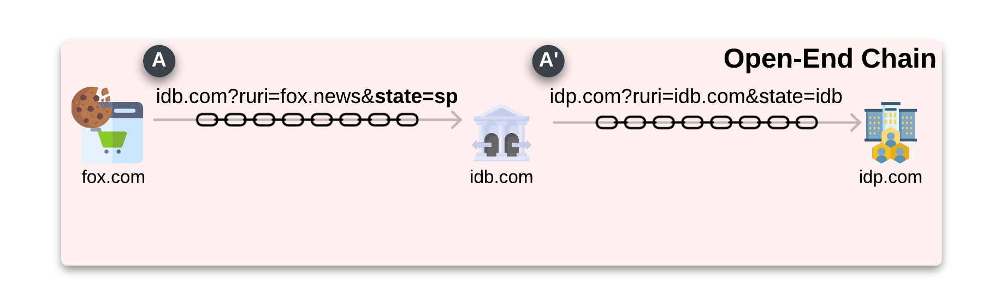
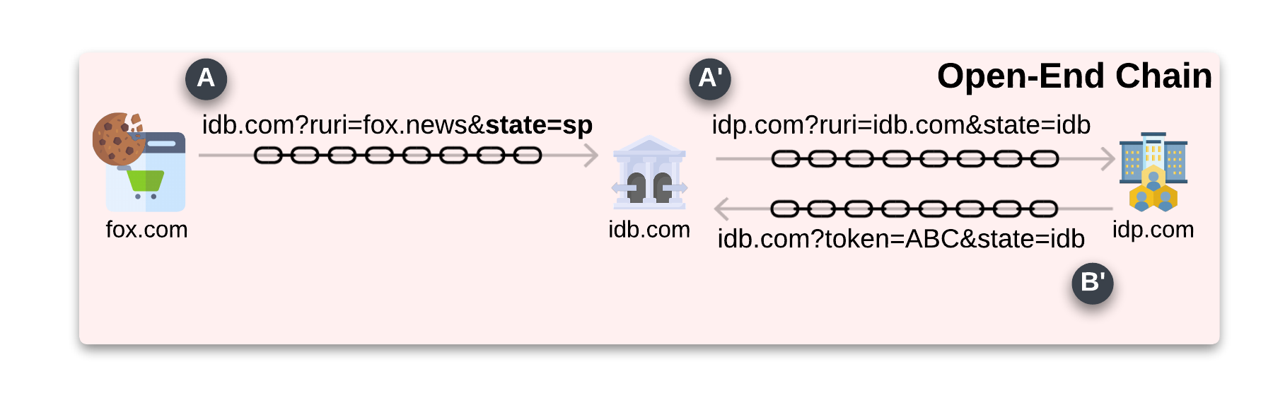
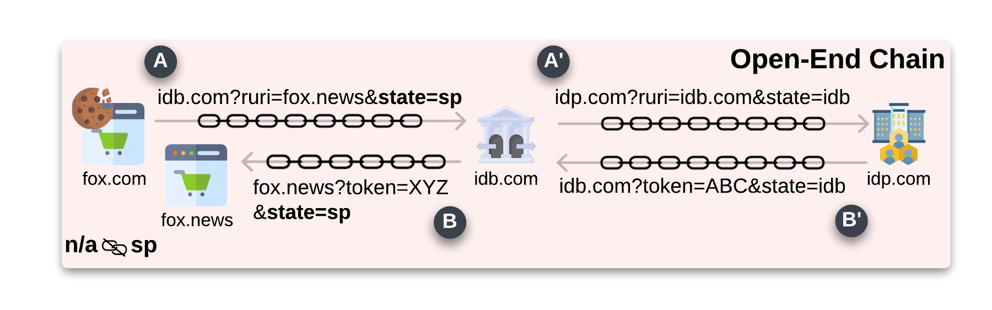
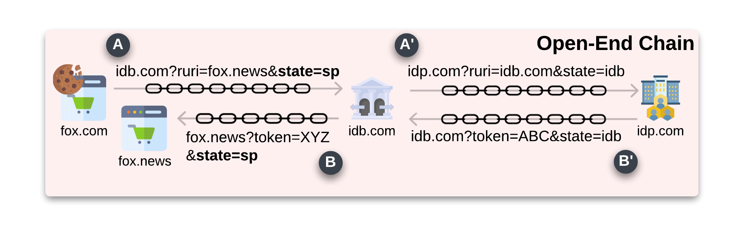
Login Request / Response Confusion
Open-End chain scheme
blocks the correct parameter validation, exposing the login flow to the LoginCSRF attack
57 Brokered SSO flows used the
Open-End chain scheme

Slide 12
Best Current Practice
1,872 violations on 2,780 websites
Identity brokers remove PKCE, exposing
brokered SSO to LoginCSRF and token leak
Identity Brokers actively downgrade the security of the login flow.

Slide 13
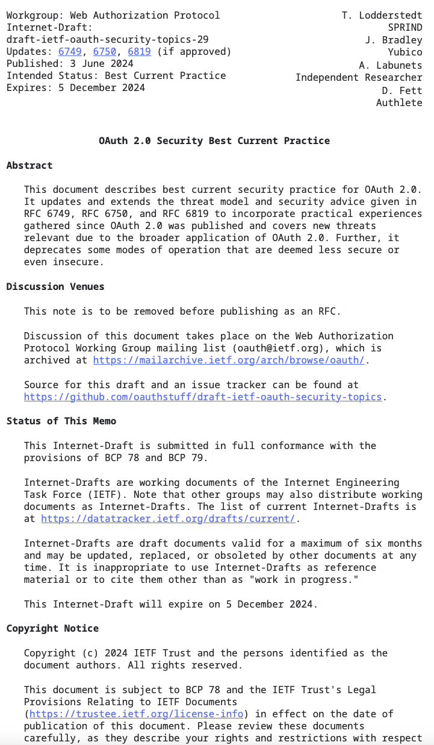
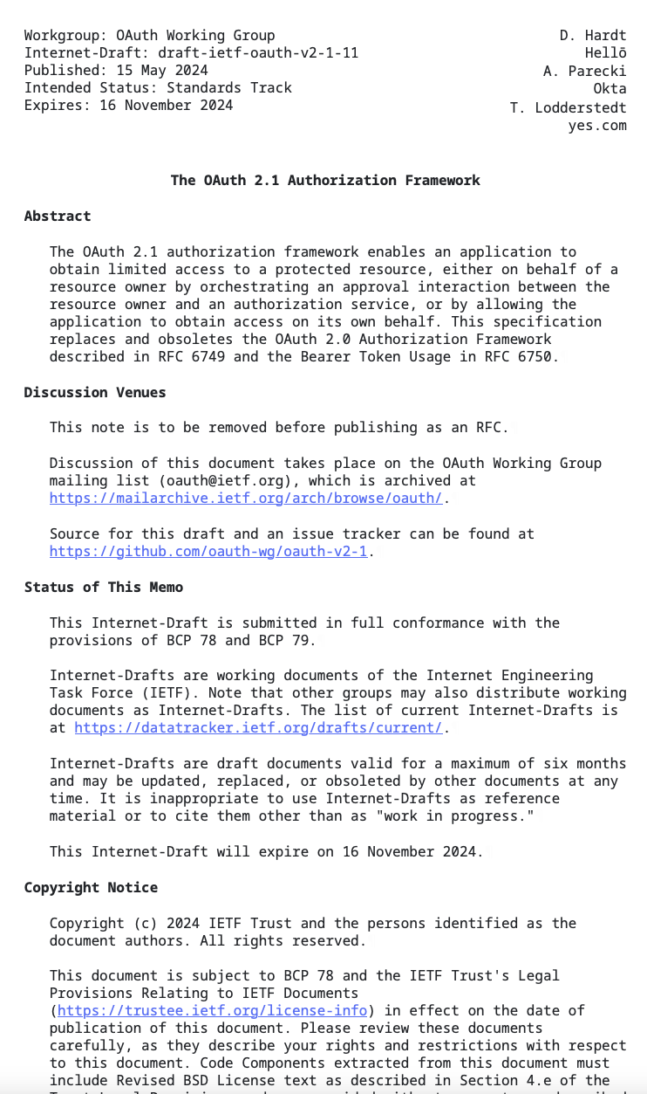
Improving the OAuth 2.1 and OAuth Security Best Current Practices
can mitigate the presented issues
The consent page in the presence of Identity Brokers should inform the user of this intermediary actor in the login flow
Introduce the requirement of using separate Client_ID for each Service Provider when the intermediary (Identity Brokers) obtains a Client_ID from an Identity provider.
A specification extension (specific use case) can confidently outline the correct implementation of Brokered SSO.

Slide 14
Identity Brokers facilitator….at what cost?
Standards have two “customers”: end-user and companies
Identity brokers are the result of failing one standard’s “customer”.
companies
Identity brokers help companies, but at what cost?
Open the discussion of the alternative and what we can do as a research community to solve the problem.

Slide 15

Thanks for your attention.
Our research artifacts:
https://zenodo.org/records/13918427

